Slide 1

Techridy
Cloud Migration
A strategic roadmap for transitioning from on-premises computing
to hybrid cloud infrastructure
IST 615
Fall 2025
John Apel
Derek Eodice
Darrell Collison

Slide 2
Our Current Reality
Why Hybrid Cloud Matters Now
The Challenge
The Opportunity
As a growing biotech company, our fully on-premises infrastructure is reaching critical limits. Research demands are increasing, computational needs are expanding, and our teams need flexible access to resources as we begin to production batches for our recently FDA approved product.
Hybrid cloud offers the perfect balance: keep sensitive research data secure on-premises while leveraging cloud scalability for non-proprietary workloads.
This isn't about abandoning what works—it's about strategic enhancement.
We're not just upgrading technology—we're enabling the next phase of scientific discovery, and manufacturing.

Slide 3



Current State vs. Proposed Future
Understanding Our Transformation
Current State
Transition Phase
Future State
100% on-premises infrastructure
Staged migration approach
Hybrid cloud architecture
Limited scalability and flexibility
Risk assessment and planning
Proprietary data remains on-premises
High capital expenditure
Team training and adoption
Non-sensitive workloads migrate to cloud
Our phased approach ensures continuity while building toward a more agile infrastructure that supports breakthrough research. This phased approach minimizes disruption, establishes cloud governance, and enables a controlled adoption of cloud technologies while maintaining on-premises control of proprietary and regulated data.

Slide 4





A Phased Migration Approach
Phase 1: Assessment
Phase 3: Migration
Inventory all systems, classify data sensitivity, and identify cloud candidates
Execute full migration of approved workloads with rollback capabilities
Phase 2: Pilot
Phase 4: Optimize
Migrate low-risk, non-sensitive workloads to validate approach and build expertise
Fine-tune performance, costs, and security posture across hybrid environment

Slide 5

Strategic Data Segmentation
What Stays On-Premises
Proprietary research data and intellectual property
Patient information and clinical trial data
Regulated compounds and formula databases
Core R&D computational models
What Moves to Cloud
Collaboration tools and productivity software
Non-sensitive analytics and reporting
Development and testing environments
Administrative and HR systems
This strategic separation ensures compliance while unlocking cloud benefits where they matter most.

Slide 6




Key Benefits of Hybrid Cloud
Infinite Scalability
Cost Optimization
Scale computational resources up or down instantly based on research demands—no more waiting for hardware procurement.
Convert capital expenses to operational expenses. Pay only for what you use, reducing waste and improving budget predictability.
Enhanced Reliability
Achieve 99.99% uptime with enterprise-grade cloud infrastructure, redundancy, and automatic failover capabilities.

Slide 7
Our Analysis
Comparison of AWS, Microsoft Azure, and GCP, vs. On-Prem
Cloud
On-Prem
AWS offers the most robust architecture: $331K (61% savings)
Azure provides best ROI with existing Microsoft licenses : $313K (63% savings)
Google Cloud Platform (GCP) excels in analytics: $365K (57% savings)
All options save $485,000–$537,000 vs. current on-prem costs
Current 3-year spending: $850K
$450,000 on infrastructure
$120,000 on maintenance
$280,000 on staffing
Key Limitations: Fixed capacity, high capital costs, limited scalability

Slide 8
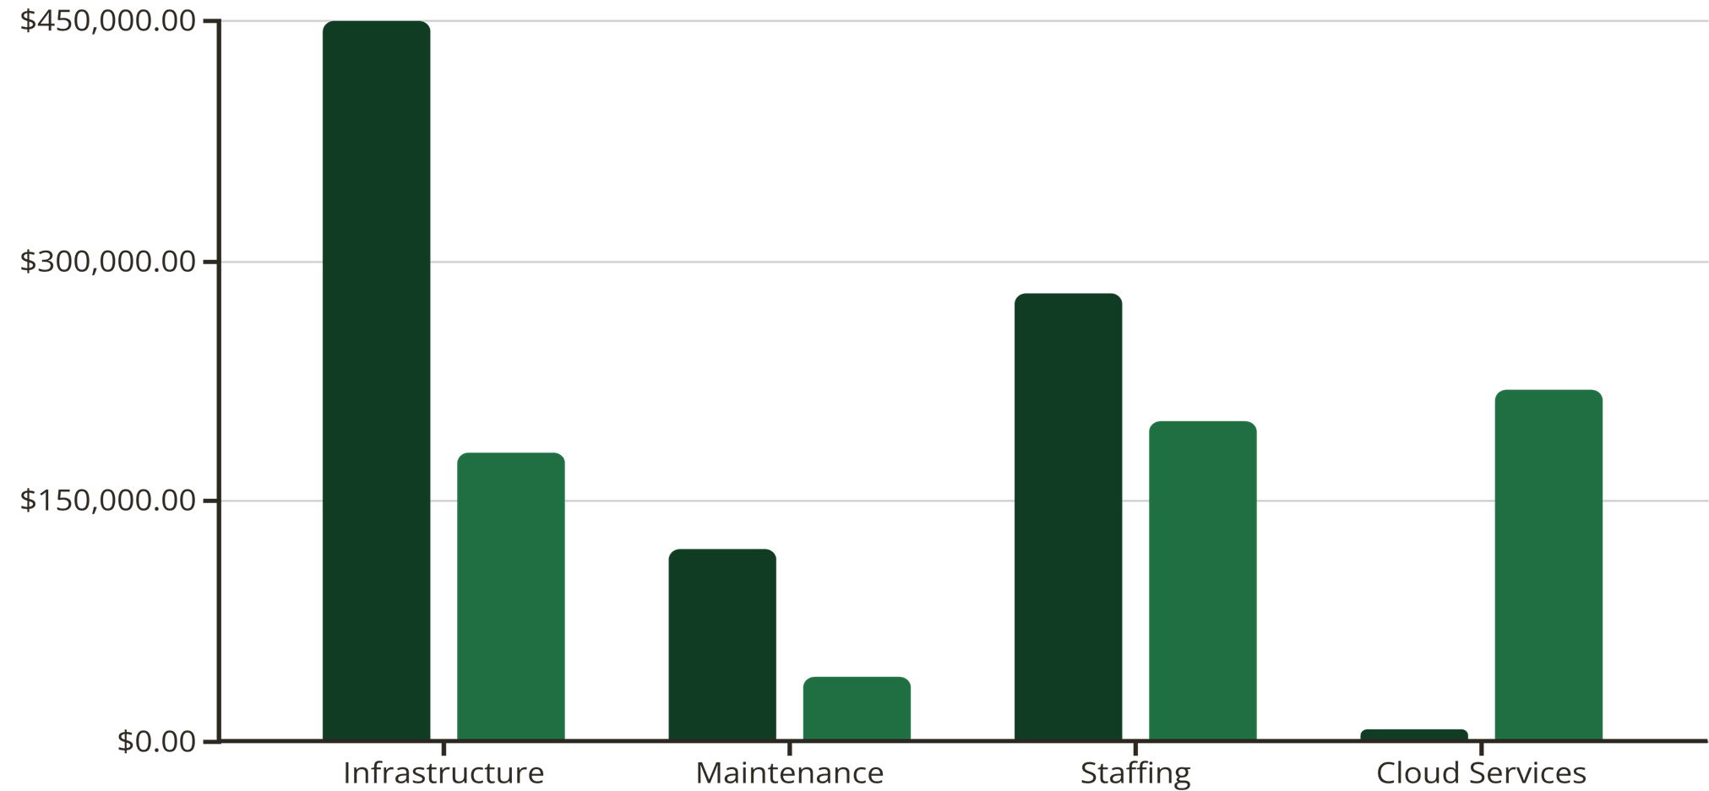
Financial Impact Analysis
https://arkenea.com/blog/cloud-computing-in-biotech, https://www.cloudzero.com/blog/cloud-pricing-comparison/

Slide 9


Culture Beats Strategy
The most sophisticated migration plan fails without organizational buy-in.
Success requires more than technical execution—it demands cultural transformation.
Address Concerns Early
Acknowledge fears about job security, skill gaps, and change fatigue.
Create forums for open dialogue and feedback.
Solve for "Yes"
When teams raise objections, dig deeper. Often concerns mask legitimate needs.
Find solutions that address root issues while moving forward.
Invest in Training
Provide cloud certifications and hands-on workshops.
Transform IT staff from infrastructure managers to cloud architects.
Build Champions
Identify early adopters across departments. Equip them with knowledge and empower them to influence peers through authentic advocacy.

Slide 10
Building Stakeholder Confidence
What Decision-Makers Need to Know
1
Strategic Rationale
2
Migration Methodology
Why migrate? Competitive advantage through agility, cost efficiency, and research acceleration while maintaining security and compliance.
How we'll execute: Phased, risk-managed approach with stage gates, pilot validation, and continuous stakeholder engagement at every step.
3
Financial Justification
4
Risk Mitigation
Investment and returns: Clear cost projections, ROI timelines, and long-term savings that strengthen our competitive position.
What's protected: Proprietary data remains on-premises, regulatory compliance maintained, and business continuity guaranteed throughout transition.
Comprehensive reporting provides transparency and builds trust with executive leadership, IT teams, and R&D stakeholders.

Slide 11
Call to Action (Funding Request)
What Decision-Makers Need to Know
Our team recommends that Techridy funds the hybrid could migration based on the financial, operational and strategic benefits outlined in this proposal.
The initiative will require an initial investment of $36,000 - $39,000 for migration activities.
However, this amount is quickly offset by the projected three-year savings of $485,000 - $537,000
Funding this project allows Techridy to do the following:
Reduce infrastructure costs by up to 63%
Accelerate research through scalable cloud resources
Maintain strict compliance by keeping sensitive data on-premises
Improve system reliability and uptime
Modernize its IT ecosystem in alignment with long-term growth
Once funded, Techridy can pilot AWS while reviewing the firm’s Microsoft licensing position to determine if Azure provides a better long-term solution.
The migration will proceed through the four phases outlined earlier: Assessment, Pilot, Migration, and Optimization.
Approving this proposal ensures that Techridy strengthens their infrastructure, while reducing costs and improving organizational agility.

Slide 12

Moving Forward Together
Key Takeaways
Hybrid cloud balances innovation with security for biotech needs
Phased migration minimizes risk while maximizing value
Financial benefits compound significantly over time
Cultural alignment is as critical as technical execution
Stakeholder buy-in requires transparency and involvement
Next Steps
Present detailed cost-benefit analysis to executive team
Form cross-functional migration steering committee
Initiate pilot program with non-critical workloads
Develop comprehensive training and change management plan

